Slide 1
Cross-scale Predictive Dictionaries for Image and Video Restoration (Paper ID: 2314)
Vishwanath Saragadam,
Aswin Sankaranarayanan,
Xin Li
Notes:
Greetings everyone, I am Vishwanath, a PhD student from CMU.
I will be talking about my paper on “Cross-scale predictive dictionaries for image and video restoration”

Slide 2







Compressive sensing
Measurement matrix
Signal of interest
$$=$$
$$M$$
$$y$$
$$M×N$$
$$N$$
$$Φ$$
$$x$$
Solving underdetermined linear system of equations
Relies on sparsity of signal
Orthogonal Matching Pursuit: Efficient recovery method
Notes:
The past one decade has seen tremendous success in applications of compressive sensing, where signals are recovered with fewer measurements than that demanded by Nyquist rate
Underlying the recovery is the idea that signals are sparse, either by themselves, through analytical bases like wavelet transform or learned bases like dictionaries
The success of compressive sensing can be attributed to the efficient recovery techniques used
We will be closely looking at one particular reconstruction technique, namely the orthogonal matching pursuit

Slide 3
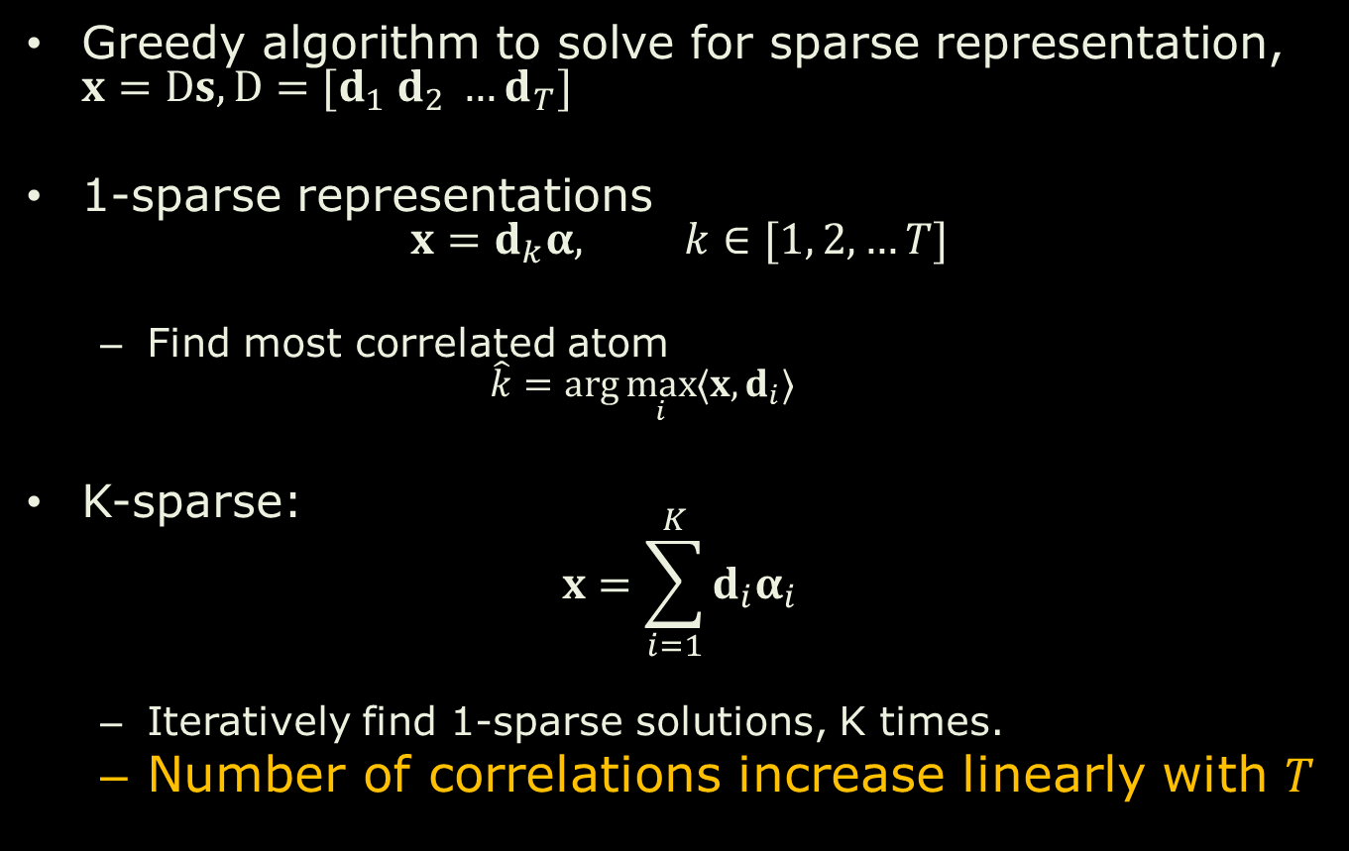
Orthogonal matching pursuit
Greedy algorithm to solve for sparse representation, $x=Ds, D=[d_{1} d_{2} …d_{T}]$
1-sparse representations $x=d_{k}α, k∈[1, 2, …T]$
Find most correlated atom $\hat{k}=\arg{\max_{i}{〈x, d_{i}〉}}$
K-sparse: $x=\sum_{i=1}^{K}{d_{i}α_{i}}$
Iteratively find 1-sparse solutions, K times.
Number of correlations increase linearly with $T$
Notes:
Orthogonal matching pursuit, at heart, is a greedy algorithm to solve for sparse approximation
Consider a 1-sparse representation of signal x, x is equal to some dk times a scalar alpha.
To find what the index k is, we simply need to find the most correlated atom with the given signal
Similarly, if we have a k-sparse signal, we iteratively solve for the set of most correlated atoms, K times
The immediate observation to make is that the number of correlations increase linearly with T.
This is very relevant to us, as approximation accuracy tends to increase with increasing T.

Slide 4
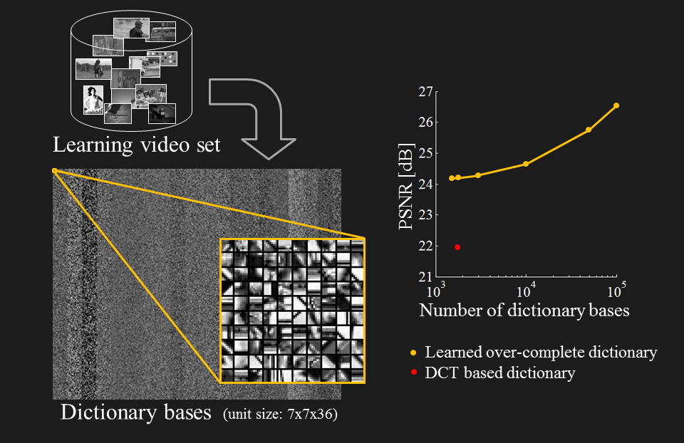
Accuracy increases with dictionary size
Y. Hitomi, J. Gu, M. Gupta, T. Mitsunaga, and S. K. Nayar. Video from a single coded exposure photograph using a learned over-complete dictionary. In IEEE Intl. Conf. Computer Vision, 2011
Notes:
Here are some experiments by Hitomi et al., which substantiate the need for very large dictionaries
As you can see in the graph on the right, a 100,000 dictionary atom for high accuracy, and with this dictionary size, it would take lots of time for reconstruction.

Slide 5
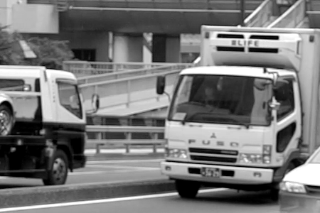
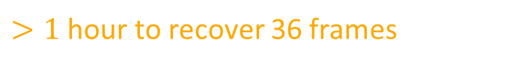
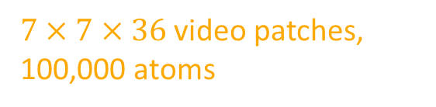
A real example: High speed video
Frames 1 - 36
Coded image
Recovered video
$7×7×36$ video patches, 100,000 atoms
$>1$ hour to recover 36 frames
Y. Hitomi, J. Gu, M. Gupta, T. Mitsunaga, and S. K. Nayar. Video from a single coded exposure photograph using a learned over-complete dictionary. In IEEE Intl. Conf. Computer Vision, 2011
Notes:
The problem at hand is a very real one and here is an example to substantiate our claim
Hitomi et al. proposed reconstruction of high speed video from low speed video by combining frames into what are called coded images.
Each pixel of the coded image is picked randomly from one of the 36 frames.
This is then expressed as a compressive sensing problem, with the video patches being sparse in certain overcomplete dictionary
The dictionary they used was made of 7x7x36 video patches with 100,000 dictionary atoms.
This took extremely long times to recover, which is bothersome.

Slide 6
Need structured dictionaries
Need very large dictionaries for high accuracy
Computational complexity increases with larger number of dictionary elements
Endow structure in dictionary to reduce search time
Notes:
What we see is that we need large dictionaries for high accuracy reconstruction
However, the reconstruction time almost linearly increases with increase in number of dictionary elements
This calls for endowing structure in dictionaries to reduce the search space in OMP algorithm
For this, we will be taking inspiration from the wavelet representation of images

Slide 7
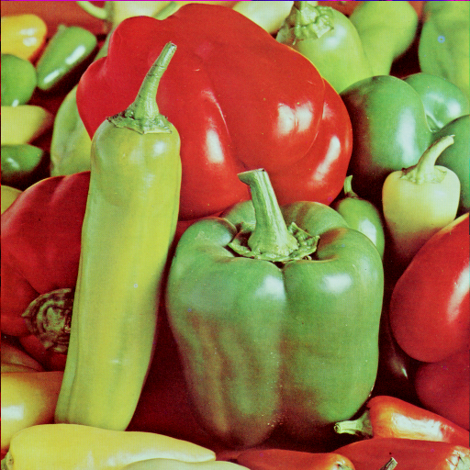
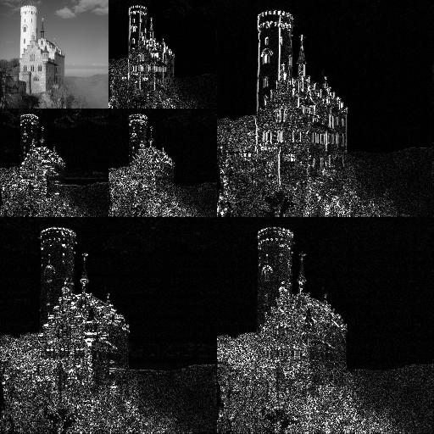
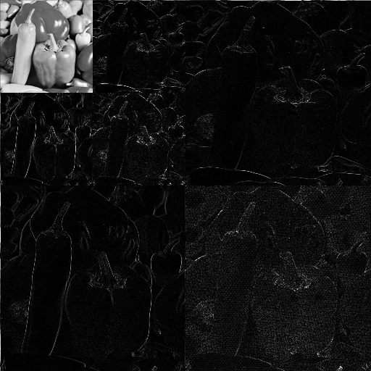


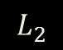
Structure across scales for visual signals
$$L_{2}$$
$$L_{1}$$
$$L_{0}$$
Image
Wavelet transform
Sparse
Multiscale
Notes:
The wavelet transform of images has certain nice properties
It is sparse
It is multiscale, which means that we can have a coarse to fine approximation

Slide 8
Wavelet zero tree
8
Wavelet transform
Parent coefficient zero
child coefficients most likely zero
Sparse
Well known only for images
Multiscale
Extend wavelet zero tree to dictionaries
Predictive
Notes:
And finally, wavelet transform is predictive
More particularly, if I know that a parent coefficient at coarser scale is zero, then with high probability, the child coefficients at finer scale are zero.
This means that once I know a parent coefficient is zero, I need not compute the child coefficients.
Unfortunately, this model is restricted to images alone.
So, can we extend the idea of zero trees to dictionaries?

Slide 9
Cross-scale predictive dictionaries

Slide 10

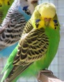
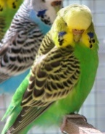
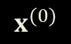
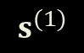
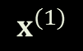
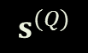

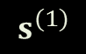
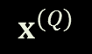
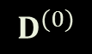
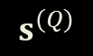


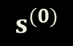
Proposed signal model
Downsample
$$x^{(Q)}$$
$$D^{(Q)}$$
$$s^{(Q)}$$
$$s^{(Q)}$$
0
$$x^{(1)}$$
$$D^{(1)}$$
$$s^{(1)}$$
$$s^{(1)}$$
0
0
0
0
0
0
$$x^{(0)}$$
$$D^{(0)}$$
$$s^{(0)}$$
0
0
0
0
0
0
0
0
$$s^{}$$
0
0
0
0
0
0
0
Signal
Dictionaries
Sparse representation
Zero tree structure of sparse coefficients
Notes:
I will first present the brief overview of what our signal model is, and then will explain the working through a toy example with two scales.
What we have at hand is a signal and its downsampled versions
For each scale of the signal, we have an associated over complete dictionary
And for each scale and dictionary we have a sparse representation
Over and above this, inspired by wavelets, we want to impose a tree structure on the coefficients, where a zero parent would imply zero children, as you can see on the very right.

Slide 11






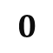



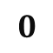

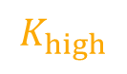

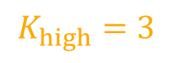

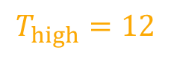


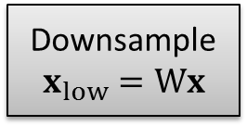
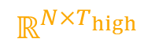
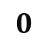
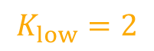
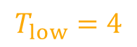

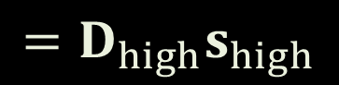

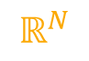


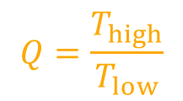
Signal model
$$ℝ^{N_{low}}$$
$$ℝ^{N_{low}×T_{low}}$$
$$K_{low}$$
Child coefficients
$$x_{low}$$
$$=D_{low}s_{low}$$
$$0$$
$$T_{low}=4$$
$$0$$
Parent coefficient
$$T_{high}=12$$
Downsample
$$x_{low}=Wx$$
$$0$$
Restrict support
$$0$$
$$0$$
$$0$$
$$x$$
$$=D_{high}s_{high}$$
$$K_{low}=2$$
$$0$$
$$0$$
$$K_{high}=3$$
$$ℝ^{N}$$
$$ℝ^{N×T_{high}}$$
$$K_{high}$$
$$s_{low}$$
$$0$$
$$0$$
Use low resolution approximation to restrict high resolution approximation
$$0$$
$$Q=\frac{T_{high}}{T_{low}}$$
$$s_{high}$$
Child atoms
Parent atom
$$D_{low}$$
$$D_{high}$$
$${\left(D_{high}\right)}_{sub}$$
Notes:
I will now explain sparse approximation for our signal model.
As you can see on the top left corner, the signal model involves downsampling x to x_low, performing sparse approximation with d_low, and then using the support of s_low to restrict the support of s_high
I’ve color coded the sparse vectors for ease of understanding.
The first sparse coefficients maps to first three in s_high, the second to the next three and so on
At the bottom, you see four atom d_low and four times three atom d_high

Slide 12
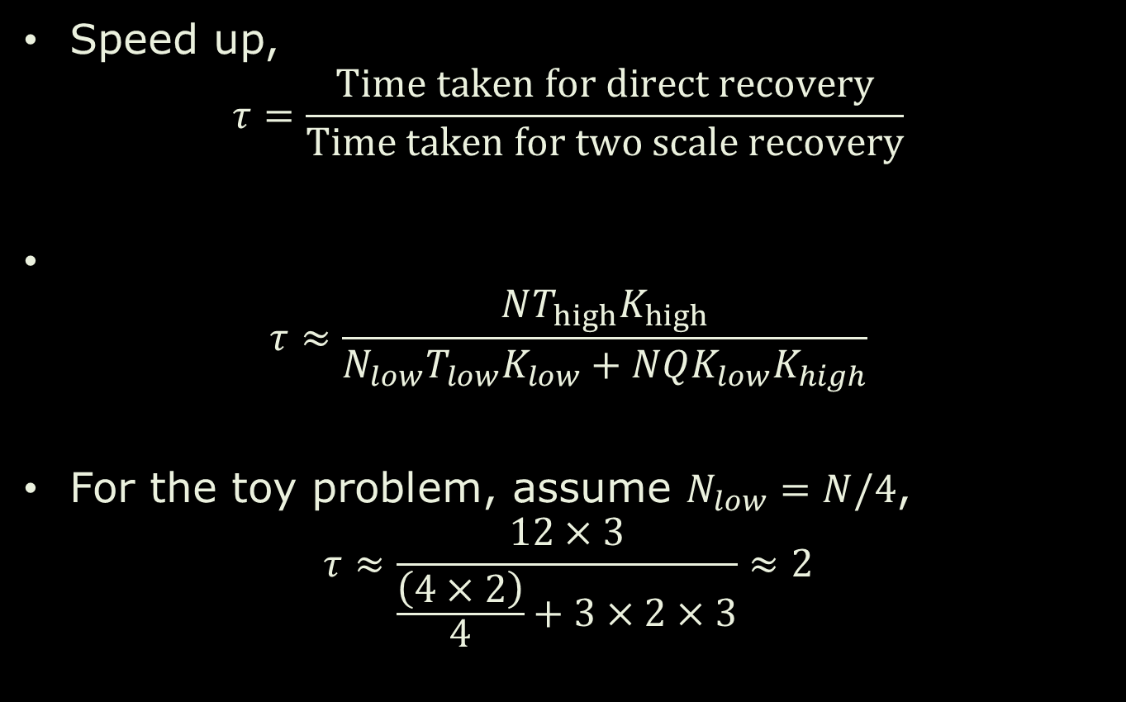
Speedup
Speed up, $τ=\frac{Time taken for direct recovery}{Time taken for two scale recovery}$
$τ≈\frac{NT_{high}K_{high}}{N_{low}T_{low}K_{low}+NQK_{low}K_{high}}$
For the toy problem, assume $N_{low}=N/4$, $τ≈\frac{12×3}{\frac{\left(4×2\right)}{4}+3×2×3}≈2$
Notes:
Let us look at the speed up we obtain
The speed up in our case would be the time taken for direct recovery by the time taken for two scale recovery
Since we are using OMP, these computation times will be predominantly be due to the most correlated atom computation, which is N T K, and hence the ratio would be …
In the case of our toy problem, we have so and so, which gives us a speed up of 2x.
This number increases as we increase in signal dimension as well as the number of dictionary elements.

Slide 13

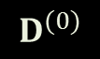
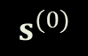
Proposed signal model
Downsample
$$x^{(Q)}$$
$$D^{(Q)}$$
$$s^{(Q)}$$
0
$$x^{(1)}$$
$$D^{(1)}$$
$$s^{(1)}$$
0
0
0
0
0
0
$$x^{(0)}$$
$$D^{(0)}$$
$$s^{(0)}$$
0
0
0
0
0
0
0
0
0
0
0
0
0
0
0
Signal
Dictionaries
Sparse representation
Zero tree structure of sparse coefficients
Use OMP at each scale
Zero tree OMP
Zero tree of coefficients
How do we learn these dictionaries?
Notes:
We use OMP to perform sparse approximation at each stage
And since the coeffficients form a zero tree,
We term our modified sparse approximation algorithm as zero tree OMP
Which brings us to our next question, how do we learn dictionaries which conform to our signal model?

Slide 14
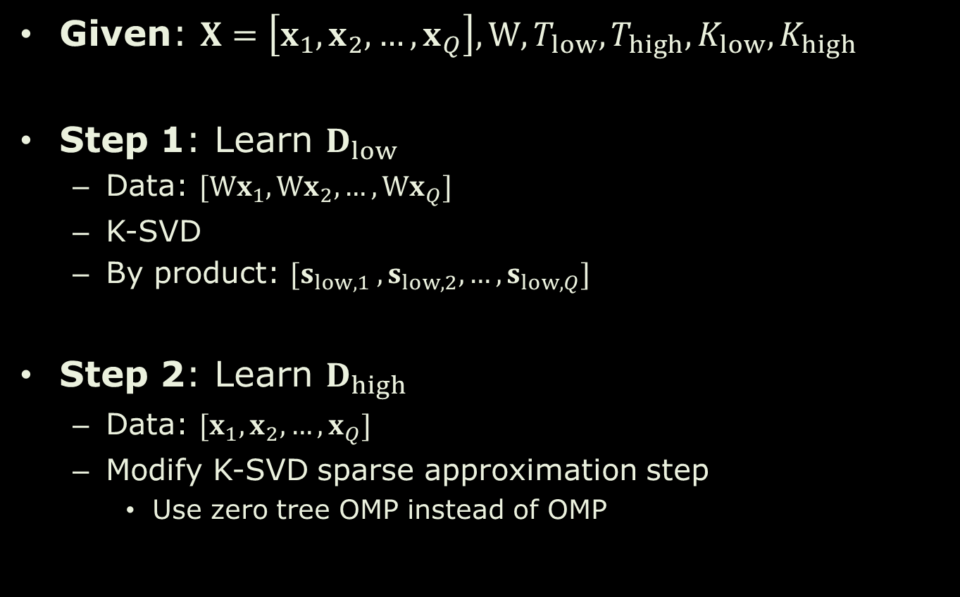
Dictionary learning
Given: $X=\left[x_{1},x_{2},…, x_{Q}\right], W, T_{low}, T_{high}, K_{low}, K_{high}$
Step 1: Learn $D_{low}$
Data: $[Wx_{1},Wx_{2},…, Wx_{Q}]$
K-SVD
By product: $[s_{low, 1} ,s_{low, 2}, …,s_{low, Q}]$
Step 2: Learn $D_{high}$
Data: $[x_{1},x_{2},…, x_{Q}]$
Modify K-SVD sparse approximation step
Use zero tree OMP instead of OMP
Recollect:
KSVD:
-- Dictionary update: Rank 1 SVD
-- Sparse approximation: OMP

Slide 15





















Dictionary learning—results
Data: 24x24 RGB patches
$D_{low}$: 12x12, 512 atoms
$D_{high}$: 24x24, 8192 atoms
$$d_{1,low}$$
$$d_{1,high} −d_{16,high}$$
(Parent atom)
(Child atoms)

Slide 16





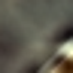











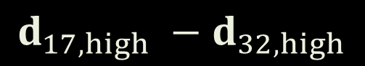
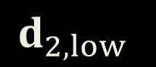
Dictionary learning—results
Data: 24x24 RGB patches
$D_{low}$: 12x12, 512 atoms
$D_{high}$: 24x24, 8192 atoms
$$d_{2,low}$$
$$d_{17,high} −d_{32,high}$$

Slide 17
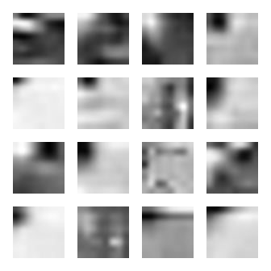




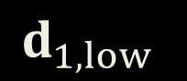
Dictionary learning – results
Data: 8x8x32 video patches
$D_{low}$: 4x4x16, 512 atoms
$D_{high}$: 8x8x32, 8192 atoms
$$d_{1,low}$$
$$d_{1,high} −d_{16,high}$$

Slide 18
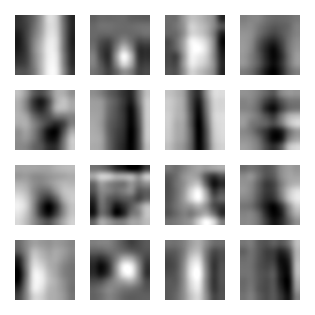

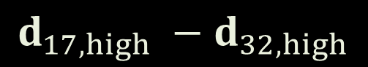

Dictionary learning – results
Data: 8x8x32 video patches
$D_{low}$: 4x4x16, 512 atoms
$D_{high}$: 8x8x32, 8192 atoms
$$d_{2,low}$$
$$d_{17,high} −d_{32,high}$$

Slide 19
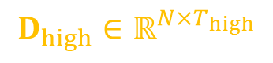
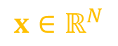
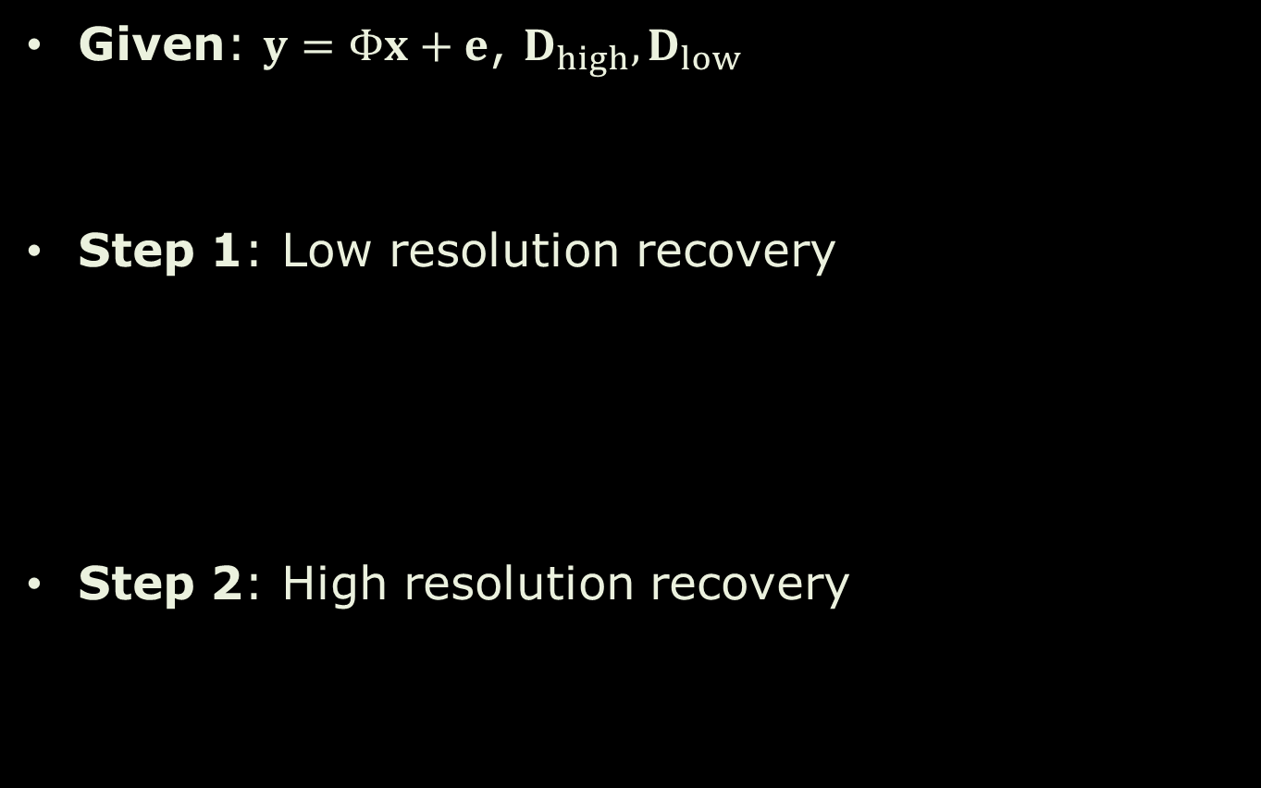
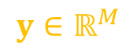

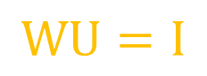

Signal recovery
Given: $y=Φx+e$, $D_{high},D_{low}$
Step 1: Low resolution recovery
Step 2: High resolution recovery
$$y∈ℝ^{M}$$
$$x∈ℝ^{N}$$
Need $s_{low}$ in the first step
$$D_{high}∈ℝ^{N×T_{high}}$$
$$D_{low}∈ℝ^{N_{low}×T_{low}}$$
$$y≈ΦU D_{low}s_{low}, {\left\|s_{low}\right\|}_{0}≤K_{low}$$
Upsampler
$$WU=I$$
$$y≈Φ {\left(D_{high}\right)}_{sub}α, {\left\|α\right\|}_{0}≤K_{high}$$

Slide 20
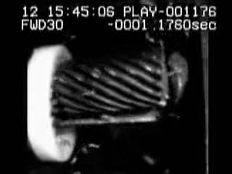

Application: Video compressive sensing
8 high speed video frames
Coded image
http://high_speed_video.colostate.edu/

Slide 21



Application: Video compressive sensing
$8192$ atom dictionary, OMP
$8×8×16$ video patches
$8192$ atom high resolution, $512$ atom low resolution, Zero tree OMP

Slide 22




Application: Video compressive sensing
$8192$ atom dictionary, OMP
$8×8×16$ video patches
$8192$ atom high resolution, $512$ atom low resolution, Zero tree OMP
Original video
Recovery using OMP
Time: 3.71 min
SNR: 15.79 dB
Recovery using zero tree OMP
Time: 16.5s
SNR: 17.81 dB
SNR $=20\log\left(\frac{\left\|x\right\|}{\left\|x−\hat{x}\right\|}\right)$
$13×$ speedup. Increase in accuracy
http://high_speed_video.colostate.edu/

Slide 23



Video compressive sensing: Real data
Coded image
Recovered video using 10,000 dictionary atoms
Time = 3 minutes
Recovered video using zero tree OMP
Time = 45 s
Thanks to Dengyu Liu and Yasunobu Hitomi for sharing the data they collected with us.

Slide 24


Accuracy plots for images
Image denoising metrics
Image inpainting with randomly deleted pixels. N/M represents the number of pixels recovered for each known pixel value.

Slide 25


Accuracy plots for videos
Video denoising metrics
Video compressive sensing. N/M represents the number of frames recovered from each coded image.

Slide 26









Summary
Downsample
$$x^{(Q)}$$
$$D^{(Q)}$$
$$s^{(Q)}$$
0
$$x^{(1)}$$
$$D^{(1)}$$
$$s^{(1)}$$
0
0
0
0
0
0
$$x^{}$$
$$D^{}$$
$$s^{}$$
0
0
0
0
0
0
0
0
0
0
0
0
0
0
0
Signal
Dictionaries
Sparse representation
Zero tree structure of sparse coefficients
Novel signal model inspired by wavelets zero tree
$>13×$ speedup
Appealing for high dimensional signals like videos
Questions?

Slide 27
Thank you

Slide 28
Extra slides

Slide 29
Model comparison table
Signal Class | N | N_{low} | T_{low} | T_{high} | K_{low} | K_{high} | Speedup | Model Accuracy (dB) | K-SVD Accuracy (dB)
Images | 8x8 | 4x4 | 64 | 1024 | 8 | 8 | 4.10 | 20.67 | 21.98
 | 24x24x3 | 12x12x3 | 512 | 8192 | 8 | 8 | 22.6 | 19.64 | 20.57
Videos | 8x8x16 | 4x4x8 | 512 | 8192 | 16 | 16 | 15.87 | 22.62 | 24.09
 | 8x8x16 | 4x4x8 | 512 | 8192 | 14 | 16 | 15.80 | 22.75 | 24.09
 | 8x8x32 | 4x4x16 | 512 | 8192 | 16 | 16 | 23.81 | 20.72 | 21.36
 | 8x8x16 | 4x4x8 | 512 | 16384 | 16 | 16 | 16.89 | 21.84 | 23.27

Slide 30

OMP – Computational Requirements
Per-iteration costs
Forming proxy O (MN)
Finding closest atom O (N)
Least squares (MxK system) O (MK²)
Dominant O (MN + MK²)
Total costs (K-iterations) O (MNK + MK³)
Notes:
1. Read about order complexity.

Slide 31

Zero tree OMP – algorithm

Slide 32

Zero tree OMP speed up computation
$x∈ℝ^{N}, x_{low}∈ℝ^{N_{low}}, D_{low}∈ℝ^{N_{low}×T_{low}}, D_{high}∈ℝ^{N×T_{high}}$
$Q=\frac{T_{high}}{T_{low}}$
Computation time for low resolution $Ο\left(N_{low}T_{low}K_{low}+N_{low}K_{low}^{3}\right)$
Computation time for high resolution $Ο\left(NQK_{low}K_{high}+NK_{high}^{3}\right)$

Slide 33

Zero tree OMP speed up computation
Computation time for OMP $Ο\left(NT_{high}K_{high}+NK_{high}^{3}\right)$
Speedup $τ≈\frac{NT_{high}K_{high}}{NQK_{low}K_{high}+N_{low}T_{low}K_{low}}$
Simple case, $K_{high}=K_{low},\frac{N_{low}}{N}=L$ $τ≈\frac{T_{high}}{QK_{low}+T_{low}L}$

